Slide 1
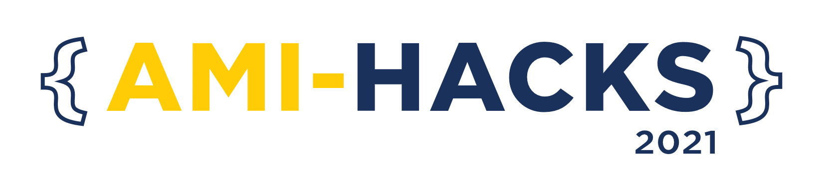
AMI-HACKS 2021 Submission Template For Participants

Slide 2
TEAM NAME and MEMBER DETAILS
Harshal Raikwar: harshalraikwar07@gmail.com, +91 9826330925, SRMIST
THEME: Open Innovation

Slide 3
PROBLEM STATEMENT
Health needs and services for various populations have come to the forefront as states work to make their systems more efficient and consider covering additional people under federal health reform implementation. Women, who are key in maintaining healthy families, access the health system more than men, both for themselves and on behalf of their children. Many become pregnant and give birth, a significant health event, then typically become their child’s primary caregiver, a role that greatly influences household health overall.

Slide 4
SOLUTION
Provide a platform to keep track of their health.
Help them to stay fit and active.
Early detection of various kind of diseases.
Build using, React Js, Flask, HTML and CSS.
Flask is used to create ML Model for the project.
Have a chatbot for your assistance.
Available in multiple languages.

Slide 5
CHECKLIST
List of features incorporated from the problem statement
Disease Prediction
Chatbot
Multilingual
Smart BMI

Slide 6
METHODOLOGY
For making the frontend I have used React Js, for building the flask models I have used Flask framework, and for styling I have used styled-components.

Slide 7


WORKING PROTOTYPE
https://youtu.be/5TbZr4_iiTE
https://github.com/Harshal0902/Women-Essential

Slide 8
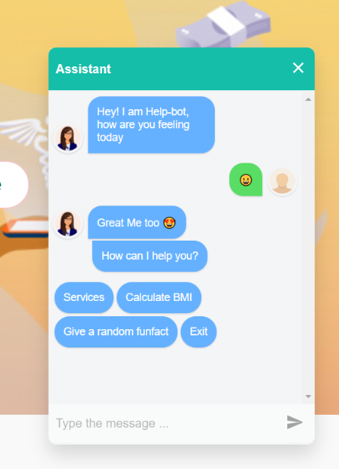
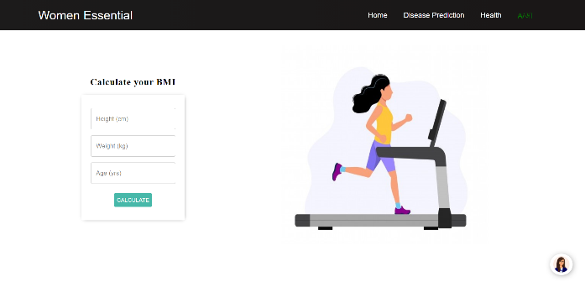
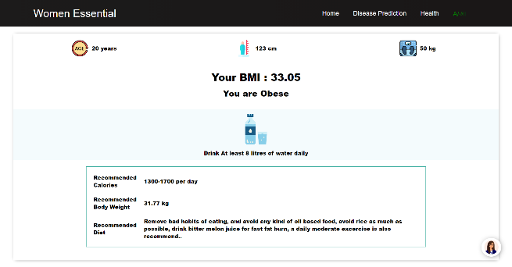
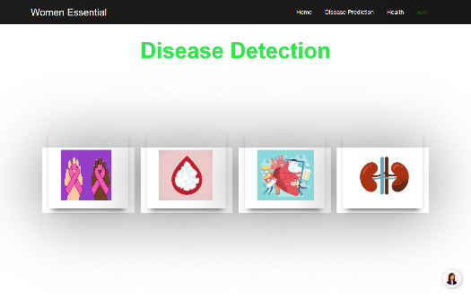
ATTACHMENTS

Slide 9

THANKS!

